Slide 1
Unit III: Concept Description: Characterization and Comparison
Notes:
The slides for this text are organized into several modules. Each lecture contains about enough material for a 1.25 hour class period. (The time estimate is very approximate--it will vary with the instructor, and lectures also differ in length; so use this as a rough guideline.) This lecture is the first of two in Module (1).
Module (1): Introduction (DBMS, Relational Model)
Module (2): Storage and File Organizations (Disks, Buffering, Indexes)
Module (3): Database Concepts (Relational Queries, DDL/ICs, Views and Security)
Module (4): Relational Implementation (Query Evaluation, Optimization)
Module (5): Database Design (ER Model, Normalization, Physical Design, Tuning)
Module (6): Transaction Processing (Concurrency Control, Recovery)
Module (7): Advanced Topics

Slide 2
Unit III: Concept Description: Characterization and Comparison
DMDL Primitives and Queries
Architectures of DM
What is concept description?
Data generalization and summarization-based characterization
Analytical characterization: Analysis of attribute relevance
Mining class comparisons: Discriminating between different classes
Mining descriptive statistical measures in large databases
Summary

Slide 3
What is Concept Description?
Descriptive vs. predictive data mining
Descriptive mining: describes concepts or task-relevant data sets in concise, summative, informative, discriminative forms
Predictive mining: Based on data and analysis, constructs models for the database, and predicts the trend and properties of unknown data
Concept description:
Characterization: provides a concise and succinct summarization of the given collection of data
Comparison: provides descriptions comparing two or more collections of data

Slide 4
Concept Description vs. OLAP
Concept description:
can handle complex data types of the attributes and their aggregations
a more automated process
OLAP:
restricted to a small number of dimension and measure types
user-controlled process

Slide 5
Data Generalization and Summarization-based Characterization
Data generalization
A process which abstracts a large set of task-relevant data in a database from a low conceptual levels to higher ones.
Approaches:
Data cube approach(OLAP approach)
Attribute-oriented induction (AOI) approach
1
2
3
4
Conceptual levels
5

Slide 6
Implementation by Cube Technology
Construct a data cube on-the-fly for the given data mining query
Facilitate efficient drill-down analysis
May increase the response time
A balanced solution: precomputation of “subprime” relation
Use a predefined & precomputed data cube
Construct a data cube beforehand
Facilitate not only the Attribute Oriented Induction(AOI), but also Attribute Relevance Analysis (ARA), dicing, slicing, roll-up and drill-down
Cost of cube computation and the nontrivial storage overhead

Slide 7
Characterization vs. OLAP
Similarity:
Presentation of data summarization at multiple levels of abstraction.
Interactive drilling, pivoting, slicing and dicing.
Differences:
Automated desired level allocation.
Dimension relevance analysis and ranking when there are many relevant dimensions.
Sophisticated typing on dimensions and measures.
Analytical characterization: data dispersion analysis.

Slide 8
Characterization: Data Cube Approach (without using Attribute Oriented-Induction)
Perform computations and store results in data cubes
Strength
An efficient implementation of data generalization
Computation of various kinds of measures
e.g., count( ), sum( ), average( ), max( )
Generalization and specialization can be performed on a data cube by roll-up and drill-down
Limitations
handle only dimensions of simple nonnumeric data and measures of simple aggregated numeric values.
Lack of intelligent analysis, can’t tell which dimensions should be used and what levels should the generalization reach

Slide 9
Attribute-Oriented Induction
Proposed in 1989 (KDD ‘89 workshop)
Not confined to categorical data nor particular measures.
How it is done?
Collect the task-relevant data( initial relation) using a relational database query
Perform generalization by attribute removal or attribute generalization.
Apply aggregation by merging identical, generalized tuples and accumulating their respective counts.
Interactive presentation with users.

Slide 10
Basic Principles of Attribute-Oriented Induction
Data focusing: task-relevant data, including dimensions, and the result is the initial relation.
Attribute-removal: remove attribute A if there is a large set of distinct values for A but (1) there is no generalization operator on A, or (2) A’s higher level concepts are expressed in terms of other attributes.
Attribute-generalization: If there is a large set of distinct values for A, and there exists a set of generalization operators on A, then select an operator and generalize A.
Attribute-threshold control: typical 2-8, specified/default.
Generalized relation threshold control: control the final relation/rule size.

Slide 11
Basic Algorithm for Attribute-Oriented Induction
InitialRel: Query processing of task-relevant data, deriving the initial relation.
PreGen: Based on the analysis of the number of distinct values in each attribute, determine generalization plan for each attribute: removal? or how high to generalize?
PrimeGen: Based on the PreGen plan, perform generalization to the right level to derive a “prime generalized relation”, accumulating the counts.
Presentation: User interaction: (1) adjust levels by drilling, (2) pivoting, (3) mapping into rules, cross tabs, visualization presentations.

Slide 12
Class Characterization: An Example
Initial Relation
Prime Generalized Relation

Slide 13
Example
DMQL: Describe general characteristics of graduate students in the Big-University database
use Big_University_DB
mine characteristics as “Science_Students”
in relevance to name, gender, major, birth_place, birth_date, residence, phone#, gpa
from student
where status in “graduate”
Corresponding SQL statement:
Select name, gender, major, birth_place, birth_date, residence, phone#, gpa
from student
where status in {“Msc”, “MBA”, “PhD” }

Slide 14
Presentation of Generalized Results
Generalized relation:
Relations where some or all attributes are generalized, with counts or other aggregation values accumulated.
Cross tabulation:
Mapping results into cross tabulation form (similar to contingency tables).
Visualization techniques:
Pie charts, bar charts, curves, cubes, and other visual forms.
Quantitative characteristic rules:
Mapping generalized result into characteristic rules with quantitative information associated with it, e.g.,

Slide 15
Presentation of Generalized Results (continued)
t-weight:
Interesting measure that describes the typicality of
each disjunct in the rule
each tuple in the corresponding generalized relation
n – number of tuples for target class for generalized relation
q_{i} … q_{n} – tuples for target class in generalized relation
q_{a} is in q_{i} … q_{n}
n
∑
t_weight
=
count(q_{a})/
count(q_{i})
i
=
1

Slide 16
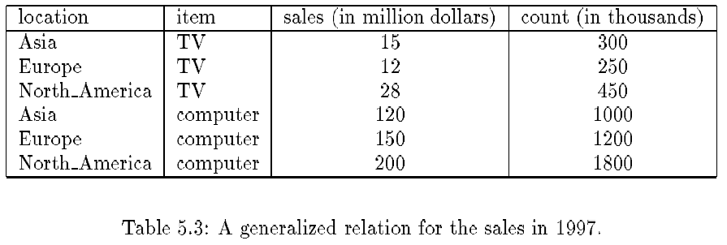
Presentation—Generalized Relation

Slide 17
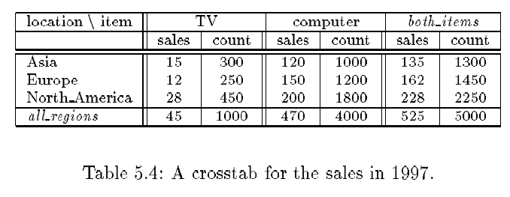
Presentation—Crosstab

Slide 18
Attribute Relevance Analysis
Why?
Which dimensions should be included?
How high level of generalization?
Automatic vs. interactive
Reduce # attributes; easy to understand patterns
What?
statistical method for preprocessing data
filter out irrelevant or weakly relevant attributes
retain or rank the relevant attributes
relevance related to dimensions and levels
analytical characterization, analytical comparison

Slide 19
Attribute relevance analysis (cont’d)
How?
Data Collection
Analytical Generalization
Use information gain analysis (e.g., entropy or other measures) to identify highly relevant dimensions and levels.
Relevance Analysis
Sort and select the most relevant dimensions and levels.
Attribute-oriented Induction for class description
On selected dimension/level
OLAP operations (e.g. drilling, slicing) on relevance rules

Slide 20
Relevance Measures
Quantitative relevance measure determines the classifying power of an attribute within a set of data.
Methods
information gain (ID3)
gain ratio (C4.5)
gini index
(Chi-Square) χ² contingency table statistics
uncertainty coefficient

Slide 21
Information-Theoretic Approach
Decision tree
each internal node tests an attribute
each branch corresponds to attribute value
each leaf node assigns a classification
ID3 algorithm
build decision tree based on training objects with known class labels to classify testing objects
rank attributes with information gain measure
minimal height
the least number of tests to classify an object

Slide 22
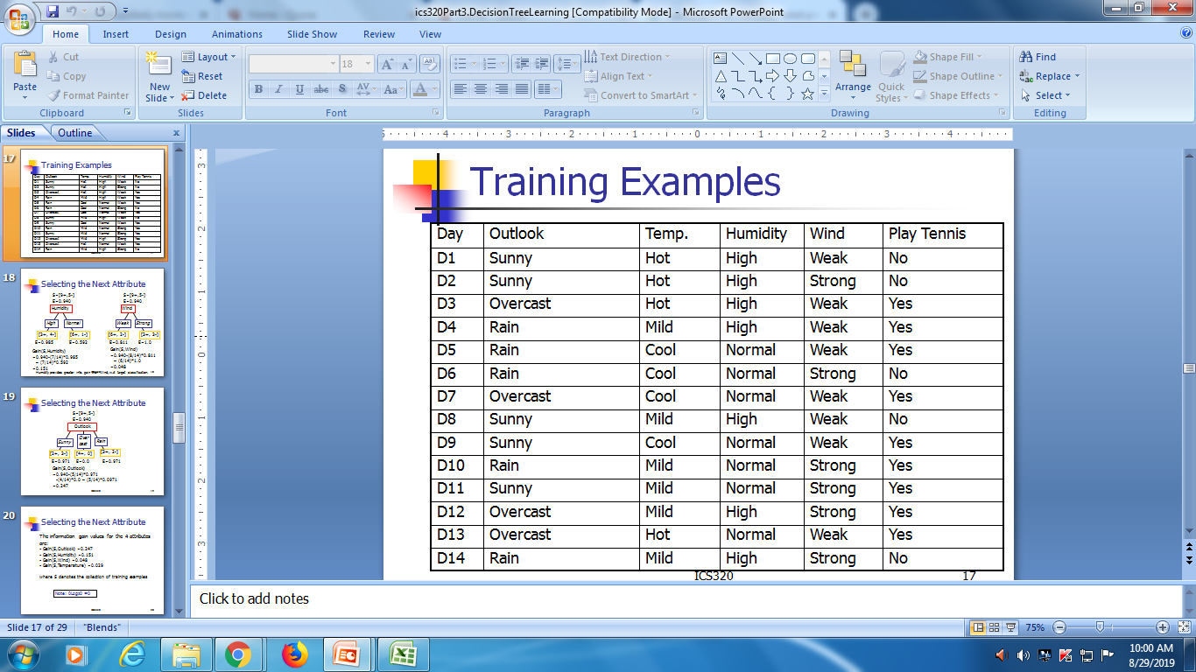
Training Examples

Slide 23
Top-Down Induction of Decision Tree
Attributes = {Outlook, Temperature, Humidity, Wind}
PlayTennis = {yes, no}
Outlook
sunny
rain
overcast
Humidity
Wind
yes
high
normal
strong
weak
no
yes
no
yes

Slide 24
Entropy and Information Gain
S contains s_{i} tuples of class C_{i} for i = {1, …, m}
Information measures info required to classify any arbitrary tuple
Entropy (weighted average) of attribute A with values {a₁,a₂,…,a_{v}}
Information gained by branching on attribute A
>info gained > discriminating attribute

Slide 25
Class Characterization: An Example
Initial Relation
Prime Generalized Relation

Slide 26
Example: Analytical Characterization
Task
Mine general characteristics describing graduate students using analytical characterization
Given
attributes name, gender, major, birth_place, birth_date, phone#, and gpa
Gen(a_{i}) = concept hierarchies on a_{i}
U_{i} = attribute analytical thresholds for a_{i}
T_{i} = attribute generalization thresholds for a_{i}
R = attribute relevance threshold

Slide 27
Example: Analytical Characterization (cont’d)
1. Data collection
target class: graduate student
contrasting class: undergraduate student
2. Analytical generalization using U_{i}
attribute removal
remove name and phone#
attribute generalization
generalize major, birth_place, birth_date and gpa
accumulate counts
candidate relation: gender, major, birth_country, age_range and gpa

Slide 28
Example: Analytical characterization (2)
Candidate relation for Target class: Graduate students (Σ=120)
Candidate relation for Contrasting class: Undergraduate students (Σ=130)

Slide 29
Example: Analytical characterization (3)
3. Relevance analysis
Calculate expected info required to classify an arbitrary tuple
Calculate entropy of each attribute: e.g. major
Number of grad students in “Science”
Number of undergrad students in “Science”

Slide 30
Example: Analytical Characterization (4)
Calculate expected info required to classify a given sample if S is partitioned according to the attribute
Calculate information gain for each attribute
Information gain for all attributes
0.9183
0.9892
0
0.9988
0.7873

Slide 31
Example: Analytical characterization (5)
4. Initial working relation (W₀) derivation
R (attribute relevance threshold) = 0.1
remove irrelevant/weakly relevant attributes from candidate relation => drop gender, birth_country
remove contrasting class candidate relation
5. Perform attribute-oriented induction on W₀ using T_{i}
Initial target class working relation W₀: Graduate students

Slide 32
Mining Class Comparisons
Comparison: Comparing two or more classes.
Method:
Partition the set of relevant data into the target class and the contrasting class(es)
Generalize both classes to the same high level concepts
Compare tuples with the same high level descriptions
Present for every tuple its description and two measures:
support - distribution within single class
comparison - distribution between classes
Highlight the tuples with strong discriminant features
Relevance Analysis:
Find attributes (features) which best distinguish different classes.

Slide 33
Example: Analytical comparison
Task
Compare graduate and undergraduate students using discriminant rule.
DMQL query
use Big_University_DB
mine comparison as “grad_vs_undergrad_students”
in relevance to name, gender, major, birth_place, birth_date, residence, phone#, gpa
for “graduate_students”
where status in “graduate”
versus “undergraduate_students”
where status in “undergraduate”
analyze count%
from student

Slide 34
Example: Analytical comparison (2)
Given
attributes name, gender, major, birth_place, birth_date, residence, phone# and gpa
Gen(a_{i}) = concept hierarchies on attributes a_{i}
U_{i} = attribute analytical thresholds for attributes a_{i}
T_{i} = attribute generalization thresholds for attributes a_{i}
R = attribute relevance threshold

Slide 35
Example: Analytical comparison (3)
1. Data collection
target and contrasting classes
2. Attribute relevance analysis
remove attributes name, gender, major, phone#
3. Synchronous generalization
controlled by user-specified dimension thresholds
prime target and contrasting class(es) relations/cuboids

Slide 36
Example: Analytical comparison (4)
Prime generalized relation for the target class: Graduate students
Prime generalized relation for the contrasting class: Undergraduate students

Slide 37
Example: Analytical comparison (5)
4. Drill down, roll up and other OLAP operations on target and contrasting classes to adjust levels of abstractions of resulting description
5. Presentation
as generalized relations, crosstabs, bar charts, pie charts, or rules
contrasting measures to reflect comparison between target and contrasting classes
e.g. count%

Slide 38
Quantitative Discriminant Rules
Cj = target class
q_{a} = a generalized tuple covers some tuples of class
but can also cover some tuples of contrasting class
d-weight
range: [0.0, 1.0] or [0%, 100%]

Slide 39
Example: Quantitative Description Rule
Quantitative description rule for target class Europe
Crosstab showing associated t-weight, d-weight values and total number (in thousands) of TVs and computers sold at AllElectronics in 1998

Slide 40
Quantitative Discriminant Rules
High d-weight in target class indicates that concept represented by generalized tuple is primarily derived from target class
Low d-weight implies concept is derived from contrasting class
Threshold can be set to control the display of interesting tuples
quantitative discriminant rule form
Read: if X satisfies condition, there is a probability (d-weight) that x is in the target class

Slide 41
Mining Data Dispersion Characteristics
Motivation
To better understand the data: central tendency, variation and spread
Data dispersion characteristics
median, max, min, quantiles, outliers, variance, etc.
Numerical dimensions correspond to sorted intervals
Data dispersion: analyzed with multiple granularities of precision
Boxplot or quantile analysis on sorted intervals
Dispersion analysis on computed measures
Folding measures into numerical dimensions
Boxplot or quantile analysis on the transformed cube

Slide 42
Measuring the Central Tendency
Mean
Weighted arithmetic mean
Median: A holistic measure
Middle value if odd number of values, or average of the middle two values otherwise
estimated by interpolation
Mode
Value that occurs most frequently in the data
Unimodal, bimodal, trimodal
Empirical formula:

Slide 43
Measuring the Dispersion of Data
Quartiles, outliers and boxplots
Quartiles: Q₁ (25th percentile), Q₃ (75th percentile)
Inter-quartile range: IQR = Q₃ – Q₁
Five number summary: min, Q₁, M, Q₃, max
Boxplot: ends of the box are the quartiles, median is marked, whiskers, and plot outlier individually
Outlier: usually, a value higher/lower than 1.5 x IQR
Variance and standard deviation
Variance s²: (algebraic, scalable computation)
Standard deviation s is the square root of variance s²

Slide 44
Boxplot Analysis
Five-number summary of a distribution:
Minimum, Q1, M, Q3, Maximum
Boxplot
Data is represented with a box
The ends of the box are at the first and third quartiles, i.e., the height of the box is IQR (interquartile range)
The median is marked by a line within the box
Whiskers: two lines outside the box extend to Minimum and Maximum

Slide 45
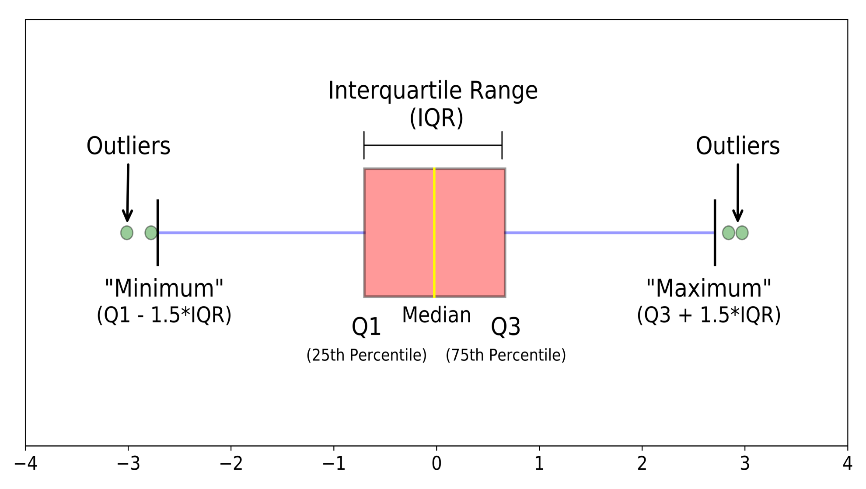
A Boxplot

Slide 46
Mining Descriptive Statistical Measures in Large Databases
Variance
Standard deviation: the square root of the variance
Measures spread about the mean
It is zero if and only if all the values are equal
Both the deviation and the variance are algebraic

Slide 47
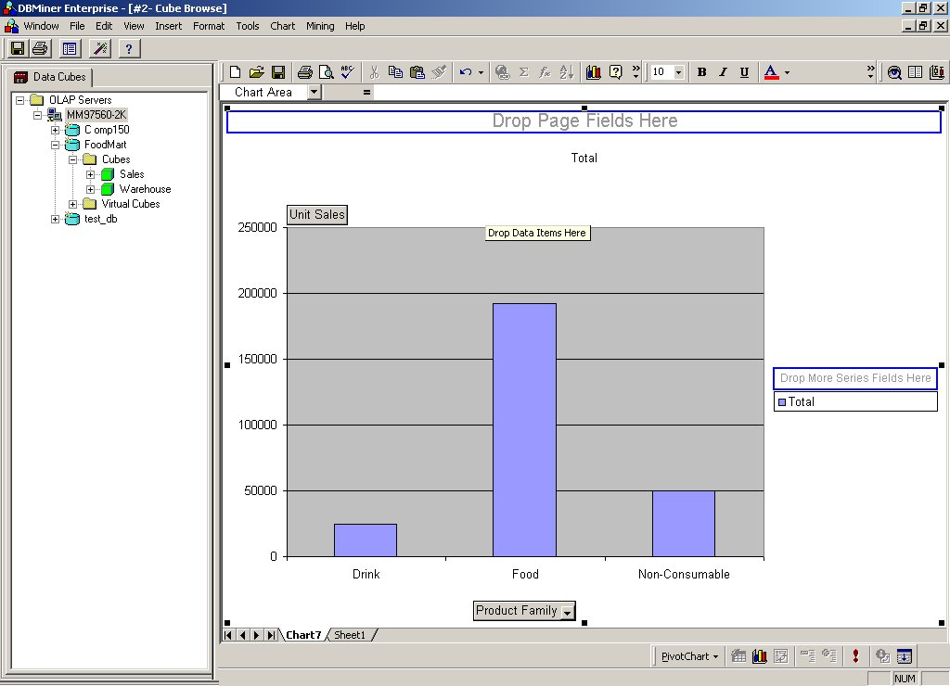
Histogram Analysis
Graph displays of basic statistical class descriptions
Frequency histograms
A univariate graphical method
Consists of a set of rectangles that reflect the counts or frequencies of the classes present in the given data

Slide 48
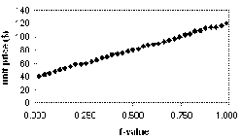
Quantile Plot
Displays all of the data (allowing the user to assess both the overall behavior and unusual occurrences)
Plots quantile information
For a data x_{i} data sorted in increasing order, f_{i} indicates that approximately 100 f_{i}% of the data are below or equal to the value x_{i}

Slide 49
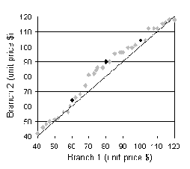
Quantile-Quantile (Q-Q) Plot
Graphs the quantiles of one univariate distribution against the corresponding quantiles of another
Allows the user to view whether there is a shift in going from one distribution to another

Slide 50
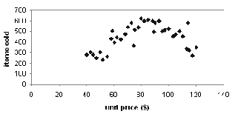
Scatter plot
Provides a first look at bivariate data to see clusters of points, outliers, etc
Each pair of values is treated as a pair of coordinates and plotted as points in the plane

Slide 51
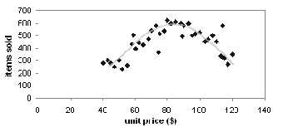
Loess Curve
Adds a smooth curve to a scatter plot in order to provide better perception of the pattern of dependence
Loess curve is fitted by setting two parameters: a smoothing parameter, and the degree of the polynomials that are fitted by the regression

Slide 52
Graphic Displays of Basic Statistical Descriptions
Histogram: (shown before)
Boxplot: (covered before)
Quantile plot: each value x_{i} is paired with f_{i} indicating that approximately 100 f_{i} % of data are ≤ x_{i}
Quantile-quantile (q-q) plot: graphs the quantiles of one univariant distribution against the corresponding quantiles of another
Scatter plot: each pair of values is a pair of coordinates and plotted as points in the plane
Loess (local regression) curve: add a smooth curve to a scatter plot to provide better perception of the pattern of dependence

Slide 53
Data Mining System Architectures
Coupling data mining system with DB/DW system
No coupling—flat file processing, not recommended
Loose coupling
Fetching data from DB/DW
Semi-tight coupling—enhanced DM performance
Provide efficient implement a few data mining primitives in a DB/DW system, e.g., sorting, indexing, aggregation, histogram analysis, multiway join, precomputation of some stat functions
Tight coupling—A uniform information processing environment
DM is smoothly integrated into a DB/DW system, mining query is optimized based on mining query, indexing, query processing methods, etc.

